Slide 1
Poisson Matting
Jian Sun1 Jiaya Jia2∗ Chi-Keung Tang2 Heung-Yeung Shum1
1Microsoft Research Asia 2Hong Kong University of Science and Technology
ACM Transactions on Graphics (TOG) Volume 23 Issue 3, August 2004
Pages 315-321

Slide 2
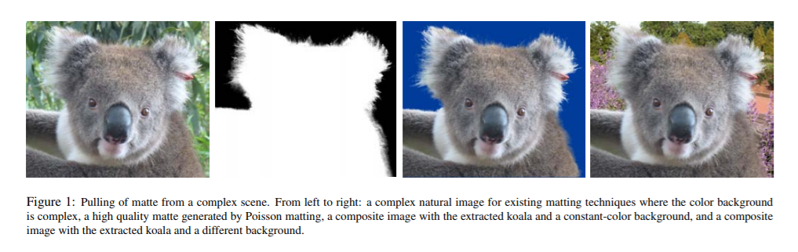
What is Poisson matting?

Slide 3
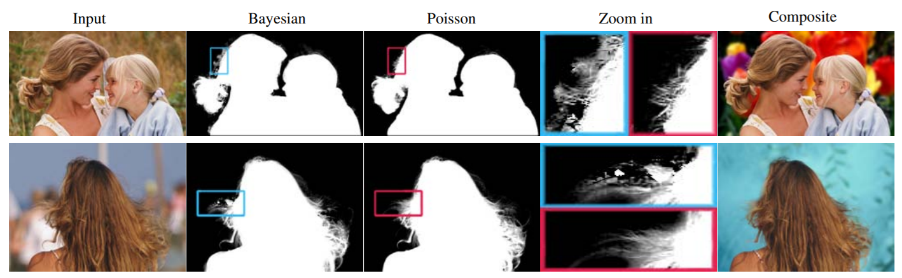
What is Poisson matting?
Advantages
- The matte is directly reconstructed from a continuous matte gradient field by solving Poisson equations using boundary information from a user-supplied trimap.
- By interactively manipulating the matte gradient field using a number of filtering tools, the user can further improve Poisson matting results locally until he or she is satisfied

Slide 4
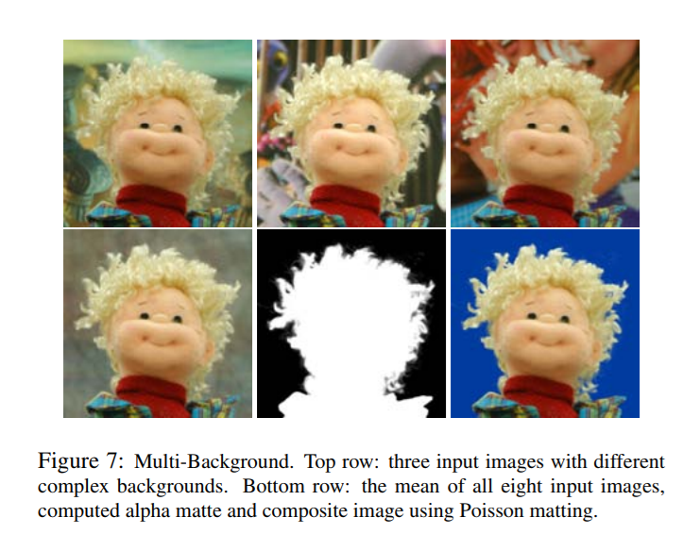
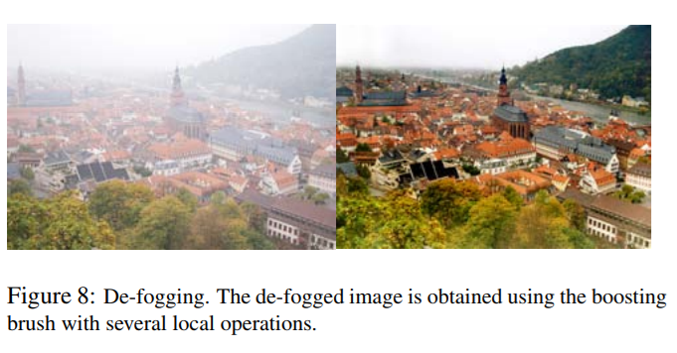
Applications
Multi-background
De-fogging

Slide 5
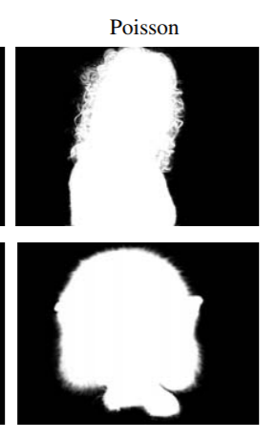

Introduction
$$I=αF+\left(1−α\right)B$$
- I(x, y): a new image
- F(x, y): a foreground image
- B(x, y): a background image
- α(x, y): a alpha matte
Alpha compositing
In computer graphics, alpha compositing is the process of combining an image with a background to create the appearance of partial or full transparency.
Wikipedia, “Alpha compositing", 24 June 2018, <https://en.wikipedia.org/wiki/Alpha_compositing>, 06 July 2018

Slide 6
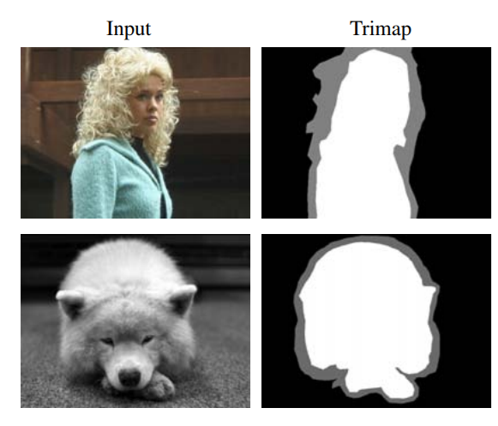
Introduction
Trimap
“unknown region”
“definitely background”
Matting is inherently under-constrained because the matting equation has too many unknowns.
The user is required to supply a trimap that partitions the image into three regions:
“definitely foreground”
In the unknown region, the matte can be estimated using the color statistics in the known foreground and background regions.

Slide 7
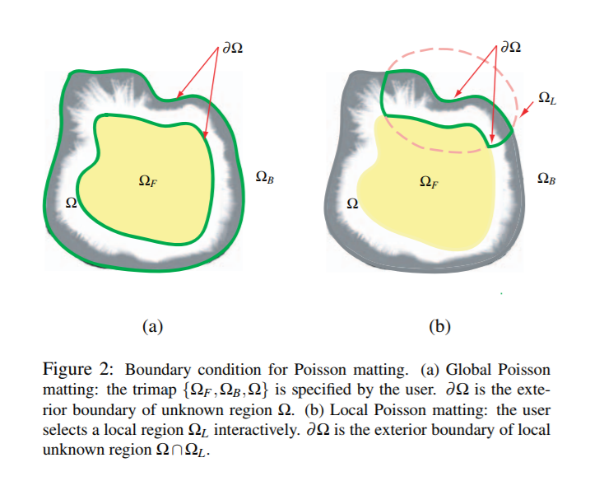
Poisson Matting
If it fails to produce high quality mattes due to a complex background
Global Poission matting
Local Poission matting

Slide 8
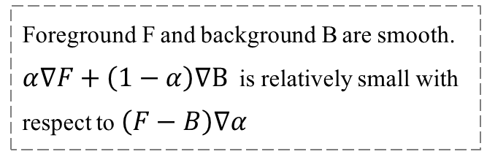

Global Poisson Matting
$$I=αF+\left(1−α\right)B$$
$$∇I=∇(αF+\left(1−α\right)B)$$
$$∇I=\left(F−B\right)∇α+α∇F+\left(1−α\right)∇B$$
Foreground F and background B are smooth.
$α∇F+\left(1−α\right)∇B$is relatively small with respect to $\left(F−B\right)∇α$
$$∇α ≈\frac{1}{F−B}∇I$$

Slide 9
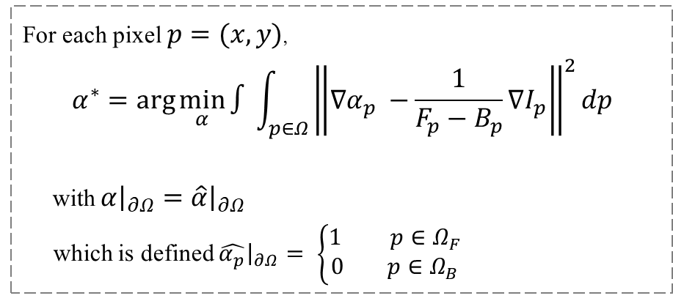




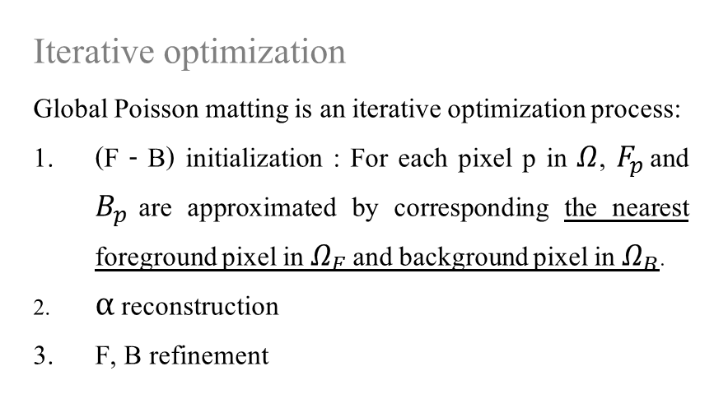
Global Poisson Matting
$$∇α ≈\frac{1}{F−B}∇I$$
Iterative optimization
Global Poisson matting is an iterative optimization process:
(F - B) initialization : For each pixel p in $Ω$, $F_{p}$ and $B_{p}$ are approximated by corresponding the nearest foreground pixel in $Ω_{F}$ and background pixel in $Ω_{B}$.
α reconstruction
F, B refinement
For each pixel $p=(x,y)$,
$$α^{∗}=\arg{\min_{α}{∫\int_{p∈Ω}{{\left\|∇α_{p} −\frac{1}{F_{p}−B_{p}}∇I_{p}\right\|}^{2}dp}}}$$
with $α{\left.​\right|}_{∂Ω}=\hat{α}{\left.​\right|}_{∂Ω}$
which is defined $\hat{α_{p}}{\left.​\right|}_{∂Ω}= \left\{\begin{aligned}1 p∈Ω_{F} \\ 0 p∈Ω_{B}\end{aligned}\right.$
$$Ω_{F}^{+}=\{p∈Ω|α_{p}>0.95, I_{p}≈F_{p}\}$$
$$Ω_{B}^{+}=\{p∈Ω|α_{p}<0.05, I_{p}≈B_{p}\}$$
$$∆α=div(\frac{∇I}{F−B})$$

Slide 10
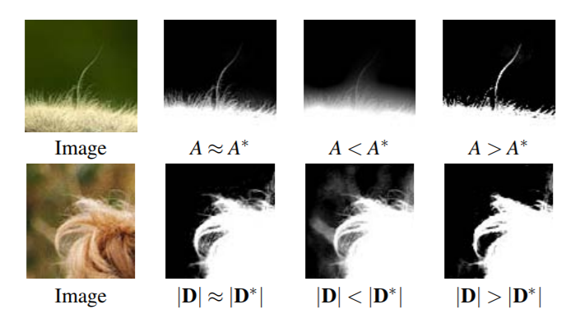

Local Poisson Matting
$$∇I=\left(F−B\right)∇α+α∇F+\left(1−α\right)∇B$$
$$∇α=A(∇I−D)$$
$$A=\frac{1}{F−B}$$
$$D=[α∇F+\left(1−α\right)∇B]$$
A
Sharpen boundaries
D
A gradient field

Slide 11
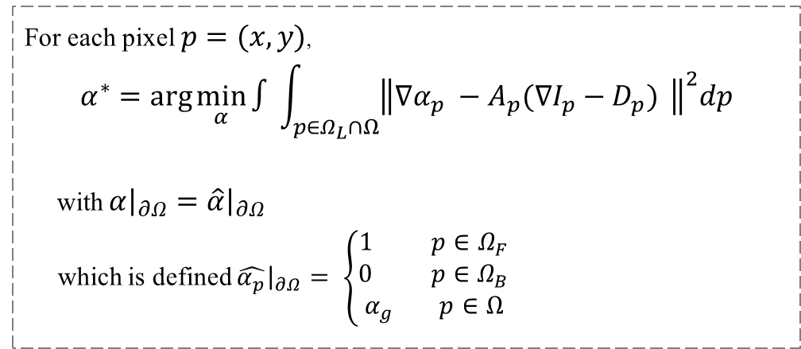
Local Poisson Matting
For each pixel $p=(x,y)$,
$$α^{∗}=\arg{\min_{α}{∫\int_{p∈Ω_{L}∩Ω}{{\left\|∇α_{p} −A_{p}(∇I_{p}−D_{p}) \right\|}^{2}dp}}}$$
with $α{\left.​\right|}_{∂Ω}=\hat{α}{\left.​\right|}_{∂Ω}$
which is defined $\hat{α_{p}}{\left.​\right|}_{∂Ω}= \left\{\begin{aligned}1 p∈Ω_{F} \\ 0 p∈Ω_{B} \\ α_{g} p∈Ω\end{aligned}\right.$
Channel selection
Local filtering
To reduce the error of D
To manipulate A and D
Boosting brush
Highpass filtering
Diffusion filtering
Clone brush
Erase brush / Inverse Brush
Usually, the local region size we use is small (fewer than 200×200 pixels), where a Poisson solver very quickly generates the matting result.

Slide 12
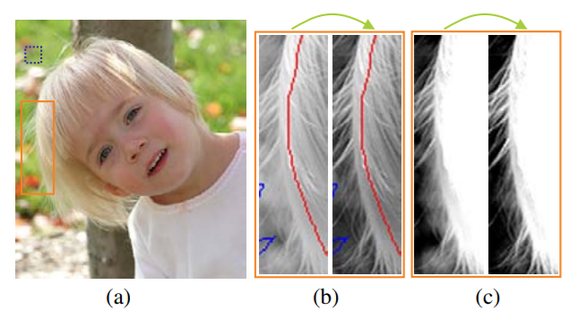

Local Poisson Matting
Channel Selection
$$\min_{a,b,c}{\sum_{i}{{\left[\left(a b c\right)∙{\left(R_{i} G_{i} B_{i}\right)}^{T} −\left(a b c\right)∙(\overline{R} \overline{G} \overline{B}) \right]}^{2}} s.t. a+b+c=1}$$
A new channel $γ=aR+bG+cB$
The error of D is reduced and the hair shape is better recovered.

Slide 13
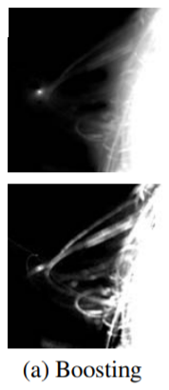
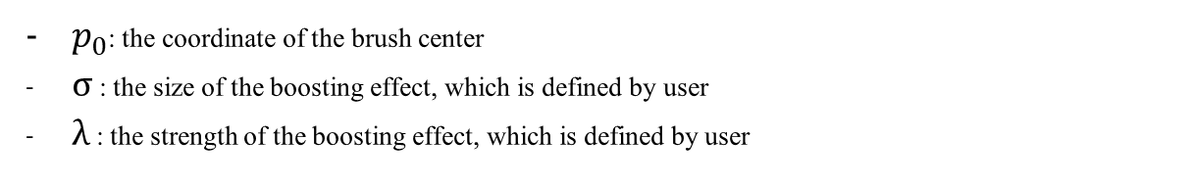
Local Poisson Matting
Local Filtering
Boosting brush.
$$A_{p}^{′}=\left[1+λ\exp\left(−\frac{{\left|\left|p−p_{0}\right|\right|}^{2}}{2σ^{2}}\right)\right]∙A_{p}$$
$p_{0}$: the coordinate of the brush center
σ : the size of the boosting effect, which is defined by user
λ : the strength of the boosting effect, which is defined by user
When the matting result is smoother or sharper than what users expect, a boosting brush can be used to increase or decrease A directly.

Slide 14
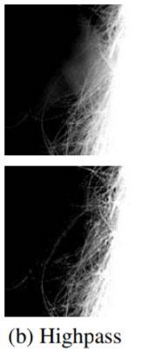

Local Poisson Matting
Local Filtering
Highpass filtering.
D can be estimated using the low-frequency part of the image gradient.
$$D=K ∗∇I$$
- $K=N(p;p_{0},σ^{2})$ : a Gaussian filter
$$∇α=A(∇I−D)$$
$$∇α=A(∇I−K ∗∇I)$$

Slide 15
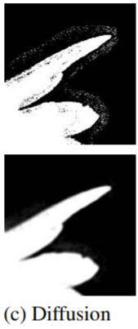
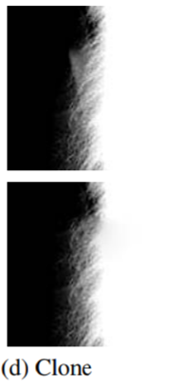
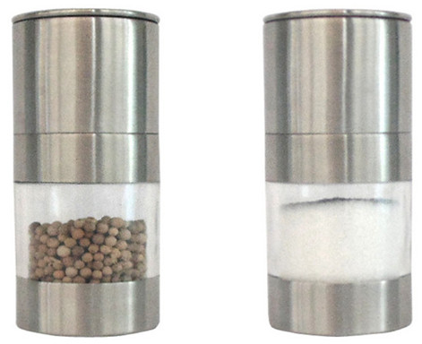
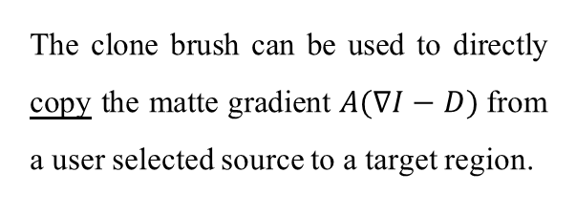
Local Poisson Matting
Local Filtering
Diffusion filtering.
Clone brush.
Adopt anisotropic diffusion [Perona and Malik. 1990] to diffuse the image. It is an edge-preserving blurring process to remove small scale noise.
The clone brush can be used to directly copy the matte gradient $A(∇I−D)$from a user selected source to a target region.
Pepper & Sault

Slide 16
Local Poisson Matting
Refinement Process
Apply channel selection to reduce the errors in D. For solid object boundaries, apply the diffusion filter to remove possible noise.
Apply the highpass filtering to obtain an approximation of D.
Apply the boosting brush to manipulate A.
Possibly apply the clone brush if gradients are indistinguishable.
Optional) Erase brush / Inverse brush

Slide 17
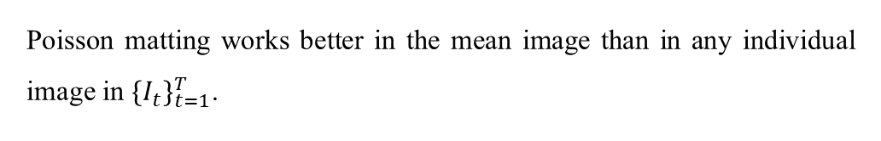


Applications
Multi-background
Without any information about backgrounds, we calculate the mean image.
$$\overline{I}=\frac{1}{T}\sum_{t}^{T}{(αF+(1−α)B_{t} )}$$
$$\frac{1}{T}∙TαF+\left(1−α\right)\frac{1}{T}\sum_{t}^{T}{B_{t}}$$
$$αF+(1−α)\overline{B}$$
Poisson matting works better in the mean image than in any individual image in ${\{I_{t}\}}_{t=1}^{T}$.

Slide 18
Applications
De-fogging
$$I=I_{c}∙e^{−βd}+Fog∙\left(1−e^{−βd}\right)$$
$$∇I_{c}=∇I∙e^{βd}$$
- Fog: the color of fog
- Ic: the clear image without fog
- β: the scattering coefficient of the atmosphere
- d: the depth value.
Use the boosting brush to locally modify $e^{βd}$in the selected region to fine tune the defogged image gradient.

Slide 19
Conclusions
In this paper, we have presented a new digital matting method, Poisson matting. By solving Poisson equations, Poisson matting reconstructs a faithful matte from its approximated gradient field estimated from an input image semi-automatically. Given a few hints using local operations, Poisson matting is capable of producing impressive results for many complex images problematic to previous natural image matting methods.
Limitations
When the foreground and background colors are very similar, the matting equation becomes ill-conditioned.
When the matte gradient estimated in global Poisson matting largely biases the true values, so that small regions need to be processed for local refinements in local Poisson matting, which increases user interaction.
When the matte gradients are highly interweaved with the gradients of the foreground and background within a very small region.

